Slide 1



Talking to people about liver disease risk
Developed by:

Slide 2
Working together
Respecting each other's experiences
Keeping confidentiality ​
Today’s an opportunity to share and learn, let's help each other do that by:​
Asking clarifying questions if needed ​
Taking a break if you need one​
britishlivertrust.org.uk | Page 2
Notes:
Please leave this slide in for all presentations

Slide 3
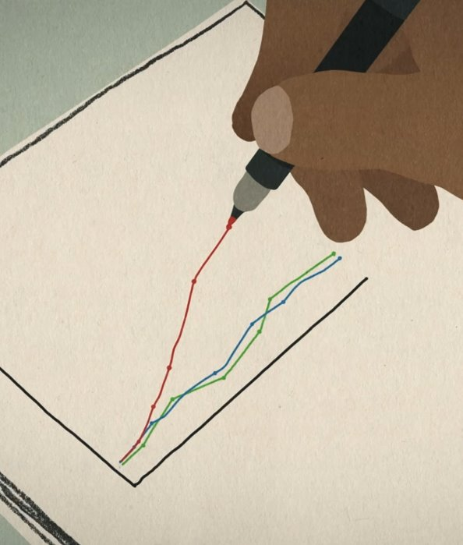
Why is this important? ​
Rates of liver disease are increasing ​
There’s social stigma around liver disease​
Many people at risk of liver disease are unaware ​
Liver disease risk can be challenging to communicate
britishlivertrust.org.uk | Page 4
Notes:
Optional slide

Slide 4
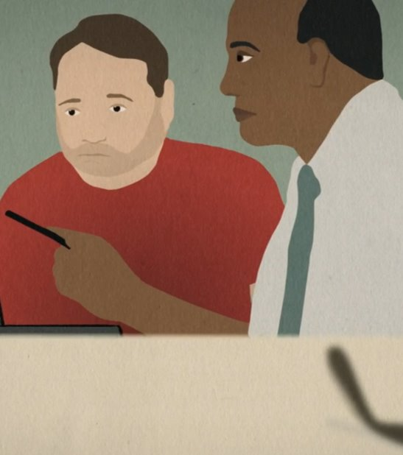
Session aims ​
To discuss how we communicate liver disease risk to patients ​
To share ideas & suggestions ​
To hear patient stories​
To reflect on practice & identify actions ​
britishlivertrust.org.uk | Page 5
Notes:
Optional slide

Slide 5
Disease statistics ​
Liver disease is one of the leading causes of death in 35-49 year olds
More than one in five of us are at risk of developing liver disease
The number of people with liver disease is increasing
Most people don't have any symptoms until their disease is at an advanced stage
9 out 10 cases of liver disease could be prevented
britishlivertrust.org.uk | Page 6
Notes:
Template slide 2

Slide 6
Perceptions of liver disease ​
British Liver Trust Stigma Survey (2022)​
​
9 out of 10 people think that liver disease is still stigmatized​
7 out of 10 people with a liver condition find it hard to even talk about their diagnosis​
Almost 1 in 3 people with a liver condition feel that stigma has prevented them from seeking or receiving the help they need​
Around half have experienced stigma from a health care professional​
britishlivertrust.org.uk | Page 7
Notes:
Template slide 2

Slide 7
Health professionals’ experiences ​
In a 2022 survey run by Vocal, healthcare professionals* shared the topics they found most challenging to talk about when discussing liver disease risk with their patients/service users.
Obesity​ | 75%​
Heavy alcohol use ​ | 44%​
Abnormal Liver Function tests ​ | 31%​
Steatosis of the liver on ultrasound ​ | 13%​
​ | ​
*Including liver doctors, consultants, allied health professionals, specialist nurses
britishlivertrust.org.uk | Page 8
Notes:
Template slide 2

Slide 8

ANIMATION
Click on the picture above or here to start the animation in a new page.

Slide 9

Discussion
What struck you about people’s experiences?​
Any similarities/differences with patients who you have spoken to? ​
britishlivertrust.org.uk | Page 10
Notes:
Optional slide

Slide 10
What’s important for people​
Everyone who took part in Liver Talks told us that they wanted health professionals to: ​
Provide advice that is mindful of the patient’s context (e.g. health inequalities, social , cultural and economic background, racial inequalities) ​
Be direct and honest about risk ​
Give individualised advice
britishlivertrust.org.uk | Page 11
Notes:
Template slide 2

Slide 11
Time to practice! ​
How would you have the first conversation first conversation about liver disease risk with one of the people in the video?​
Approach this conversation being mindful of the social and cultural contexts of the patient. ​
You could use this structure as a guide​
​
An opener (how would you introduce the conversation?) ​
Information about the general risk / the context ​
Explain the individual risk and how they can reduce it​
Signpost to other sources of information - being culturally aware​
britishlivertrust.org.uk | Page 12
Notes:
Template slide 2

Slide 12

Final reflections ​
What are you taking away from today? ​
How could you be further supported to have these conversations?
britishlivertrust.org.uk | Page 13
Notes:
Optional slide

Slide 13







Liver Talks Partners ​
Funded by:
britishlivertrust.org.uk | Page 14
Notes:
Template slide 2

Slide 14
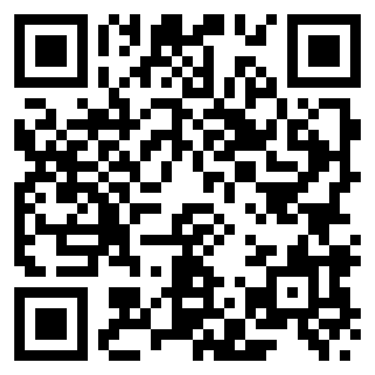
Feedback
Answer two questions about Liver Talks by following the QR Code below.
britishlivertrust.org.uk | Page 14
Notes:
Template slide 2

Slide 15



Thank you - please stay in touch
Sign up to our newsletter at britishlivertrust.org.uk
Email us at info@britishlivertrust.org.uk
Follow us at:
@LiverTrust british_liver_trust
British Liver Trust
britishlivertrust.org.uk | Page 15

